Slide 1
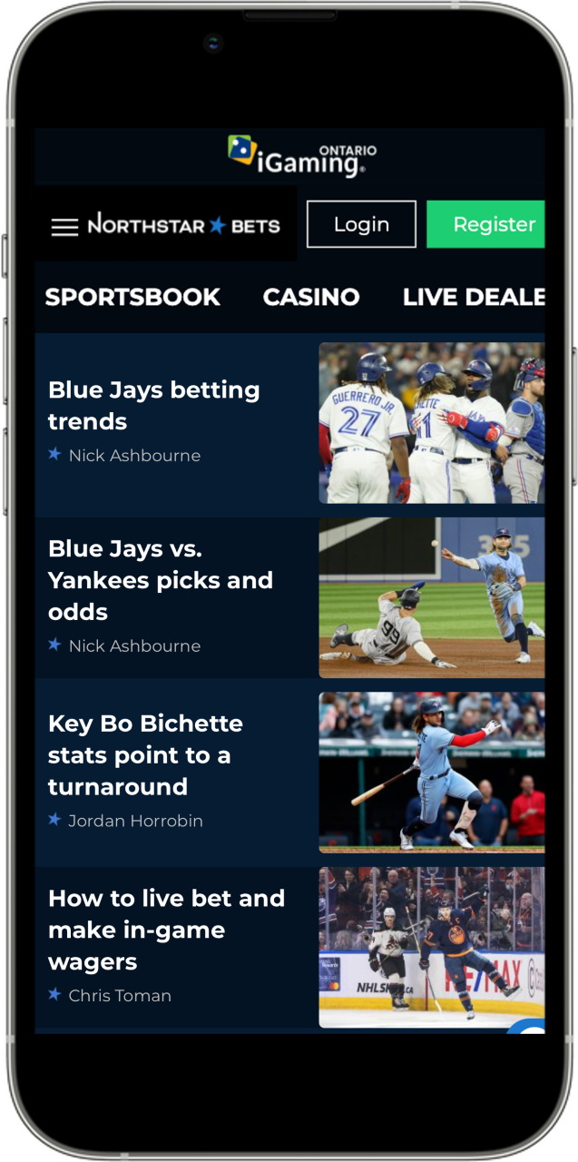
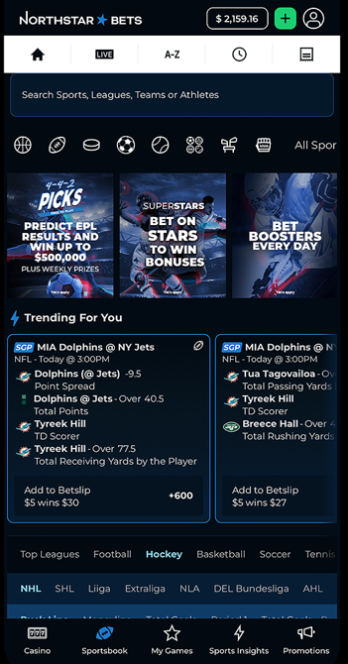
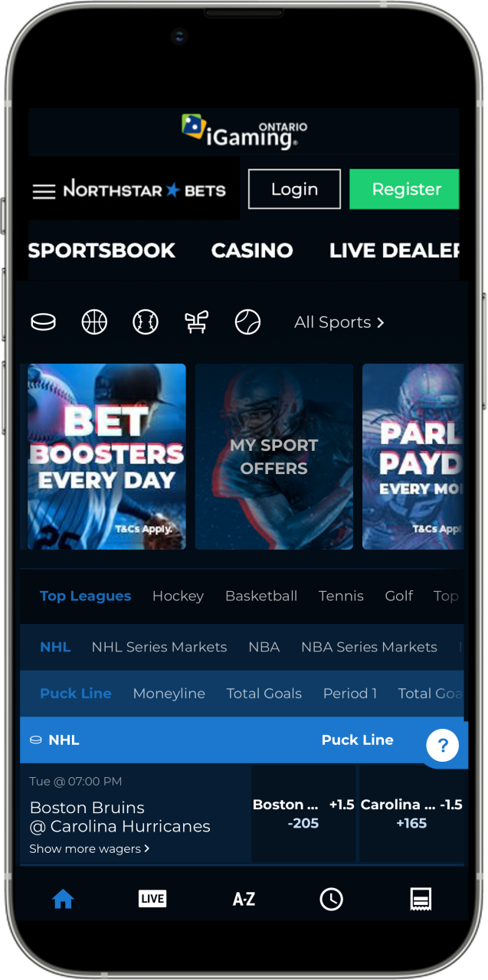


TSXV: BET
Investor Presentation
January 2024

Slide 2
DISCLAIMER
Cautionary Statement
The information contained in this presentation has been prepared by NorthStar Gaming Inc. (the “Company”) and contains confidential information pertaining to the business and operations of the Company. The information contained in this presentation: (a) is provided as at the date hereof, is subject to change without notice, and is based on publicly available information, internally developed data as well as third party information from other sources; (b) is not to be considered as a recommendation by the Company that any person make an investment in the Company; and (c) is for information purposes only. Where any opinion or belief is expressed in this presentation, it is based on certain assumptions and limitations and is an expression of present opinion or belief only. The third party information has not been independently verified. While the Company may not have verified the third party information, it believes that it obtained the information from reliable sources and has no reason to believe it is not accurate in all material respects. No warranties or representations can be made as to the origin, validity, accuracy, completeness, currency or reliability of the information. The Company disclaims and excludes all liability (to the extent permitted by law), for losses, claims, damages, demands, costs and expenses of whatever nature arising in any way out of or in connection with the information in this presentation, its accuracy, completeness or by reason of reliance by any person on any of it.
Trademarks
This presentation may contain trademarks, service marks, trade names and copyrights of other companies, which are the property of their respective owners. Solely for convenience, some of the trademarks, service marks, trade names and copyrights referred to in this presentation may be listed without the TM, SM © or ® symbols, but we will assert, to the fullest extent under applicable law, the rights of the applicable owners, if any, to these trademarks, service marks, trade names and copyrights.
Forward-Looking Information
This presentation contains "forward-looking information" within the meaning of applicable securities laws in Canada. Forward-looking information may relate to future events or future performance of the Company. All statements in this presentation, other than statements of historical facts, with respect to the Company's objectives and goals, as well as statements with respect to its beliefs, plans, objectives, expectations, anticipations, estimates, and intentions, are forward-looking information. Specific forward-looking statements in this presentation include, but are not limited to: expectations regarding certain of the Company's future results, including, among other things, revenue, expenses, revenue growth, capital expenditures, and operations; the total addressable market in Ontario and Canada; expectations regarding the regulatory control and expansion of sports betting and online gaming in Canada and elsewhere and the related timing thereof and the Company’s intention and ability to participate in such markets; the impact of competition on the Company, including with respect to client acquisition costs and payback rates / ratios; the intentions of the Company with respect to future acquisitions; the Company entering into new markets; the development and function of the Company’s products and services, and the Company’s ability to market successfully to customers. Often, but not always, forward-looking information can be identified by the use of words such as "plans", "expects", "is expected", "budget", "scheduled", "estimates", "continues", "forecasts", "projects", "predicts", "intends", "anticipates" or "believes", or variations of, or the negatives of, such words and phrases, or state that certain actions, events or results "may", "could", "would", "should", "might" or "will" be taken, occur or be achieved. This information involves known and unknown risks, uncertainties and other factors that may cause actual results or events to differ materially from those anticipated in such forward-looking information.
Forward-looking information contained in this presentation is based on certain assumptions and analyses made by the Company in light of the experience and perception of historical trends, current conditions and expected future developments and other factors it believes are appropriate and are subject to risks and uncertainties, including, but not limited to, risks and uncertainties concerning and related to the regulatory environment in Canada and abroad. The forward-looking information contained herein reflect management’s current expectations and beliefs and are based upon certain assumptions that management believes are reasonable based on the information currently available to management. Such assumptions include, but are not limited to, assumptions regarding: (a) the demand for our products and services and fluctuations in future revenues; (b) sufficiency of current working capital to support future operating and working capital requirements; (c) equity and debt markets continuing to provide access to capital on acceptable terms; (d) general economic trends and conditions; (e) the expected actions of third parties; (f) the Company’s future growth prospects and business opportunities; (g) regulatory control and expansion of sports betting and online gaming in Canada and elsewhere and the Company’s intention and ability to participate in such markets; (h) expectations with respect to the renewal and/or extension of the Company’s permits, licenses and registrations; (i) capital cost of the Company’s expansion; (j) the competitive conditions in the industry in which the Company operates; (k) the applicable laws, regulations and any amendments thereof; (l) the grant and impact of any license, permit or registration for sports betting and online gaming or any amendments thereof; (m) the Company’s ability to comply with applicable governmental regulations and standards; (n) the Company’s success in implementing its strategies and achieving its business objectives; (o) the number of markets to be entered by the Company; (p) policies of enforcement; and (q) general business and economic conditions.
The Company believes the expectations reflected in the forward-looking information contained herein are reasonable but no assurance can be given that these expectations will prove to be correct and such forward-looking information included herein should not be unduly relied upon. Information contained in forward-looking statements in this presentation is provided as of the date hereof and the Company disclaims any obligation to update any forward-looking statements, whether as a result of new information or future events or results, except to the extent required by applicable securities laws.
The forward-looking information contained herein is subject to risks, uncertainties and other factors, including those described in our listing application for listing on the TSX Venture Exchange, which is dated as of March 3, 2023 and is publicly available on SEDAR.

Slide 3
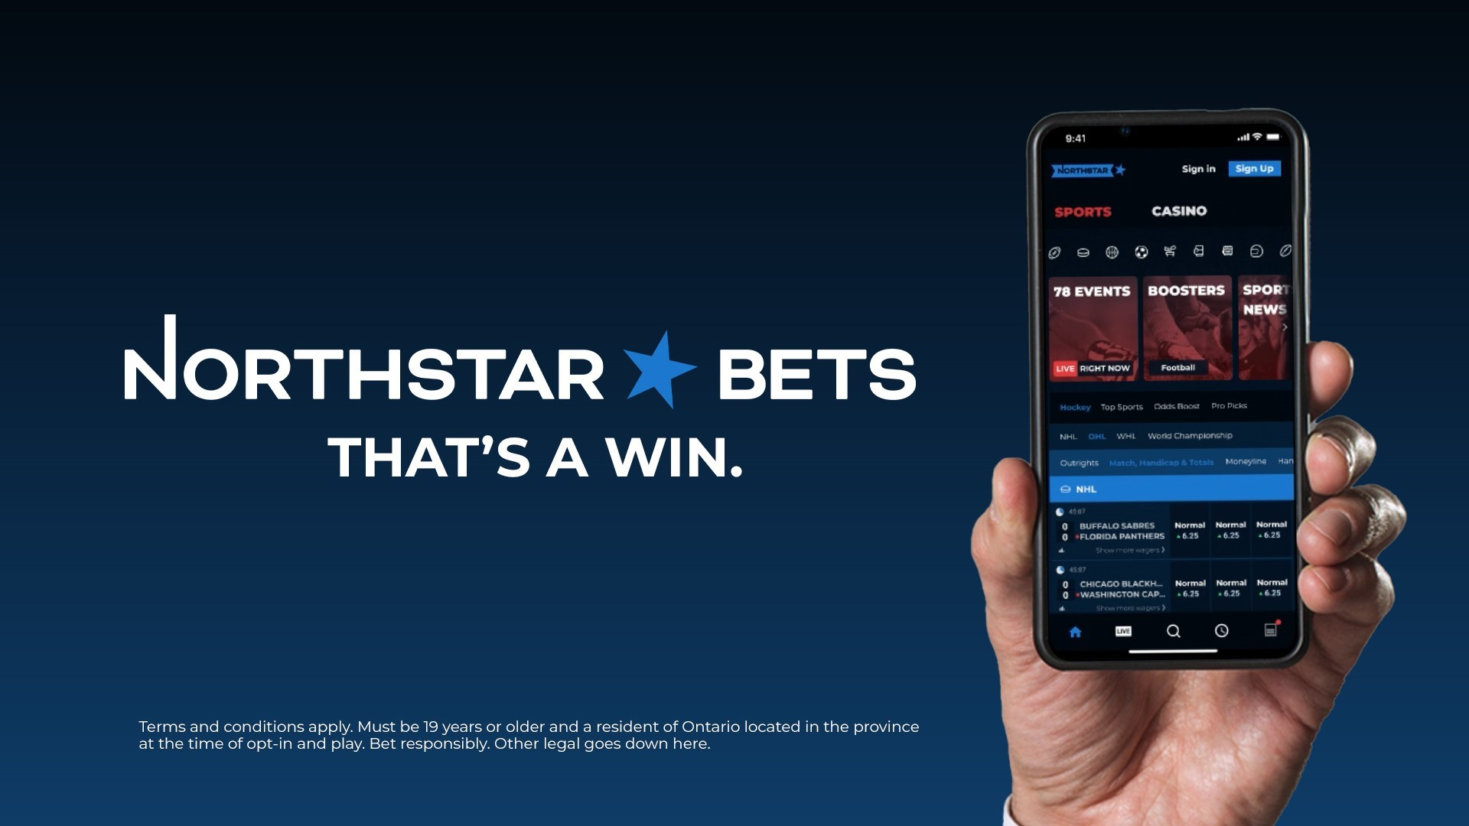
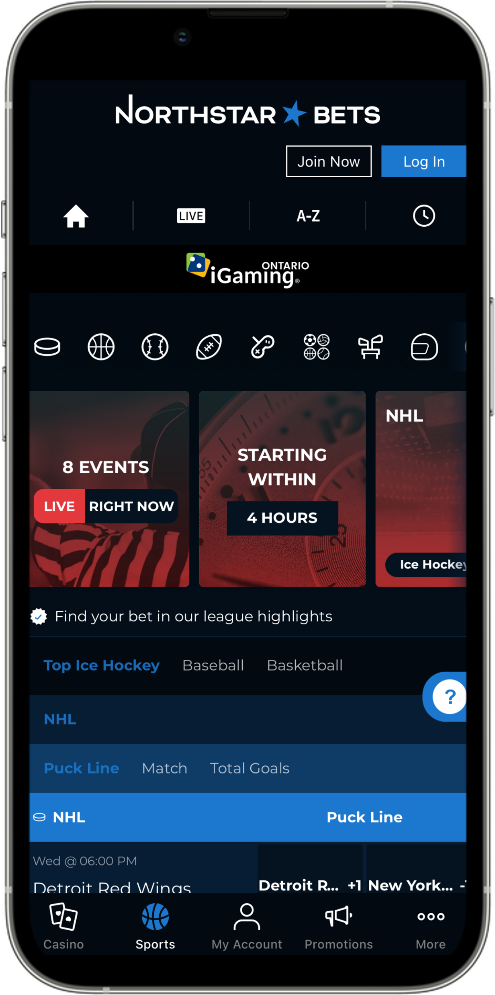
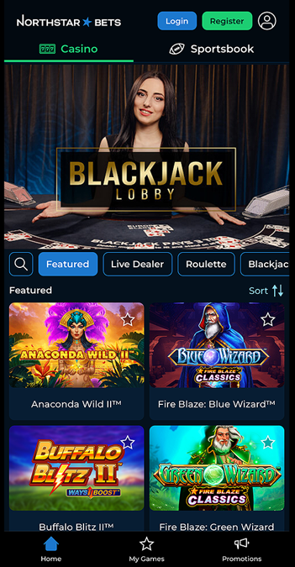


SPEARHEADING THE INTERSECTION OF
iGAMING AND MEDIA

Slide 4
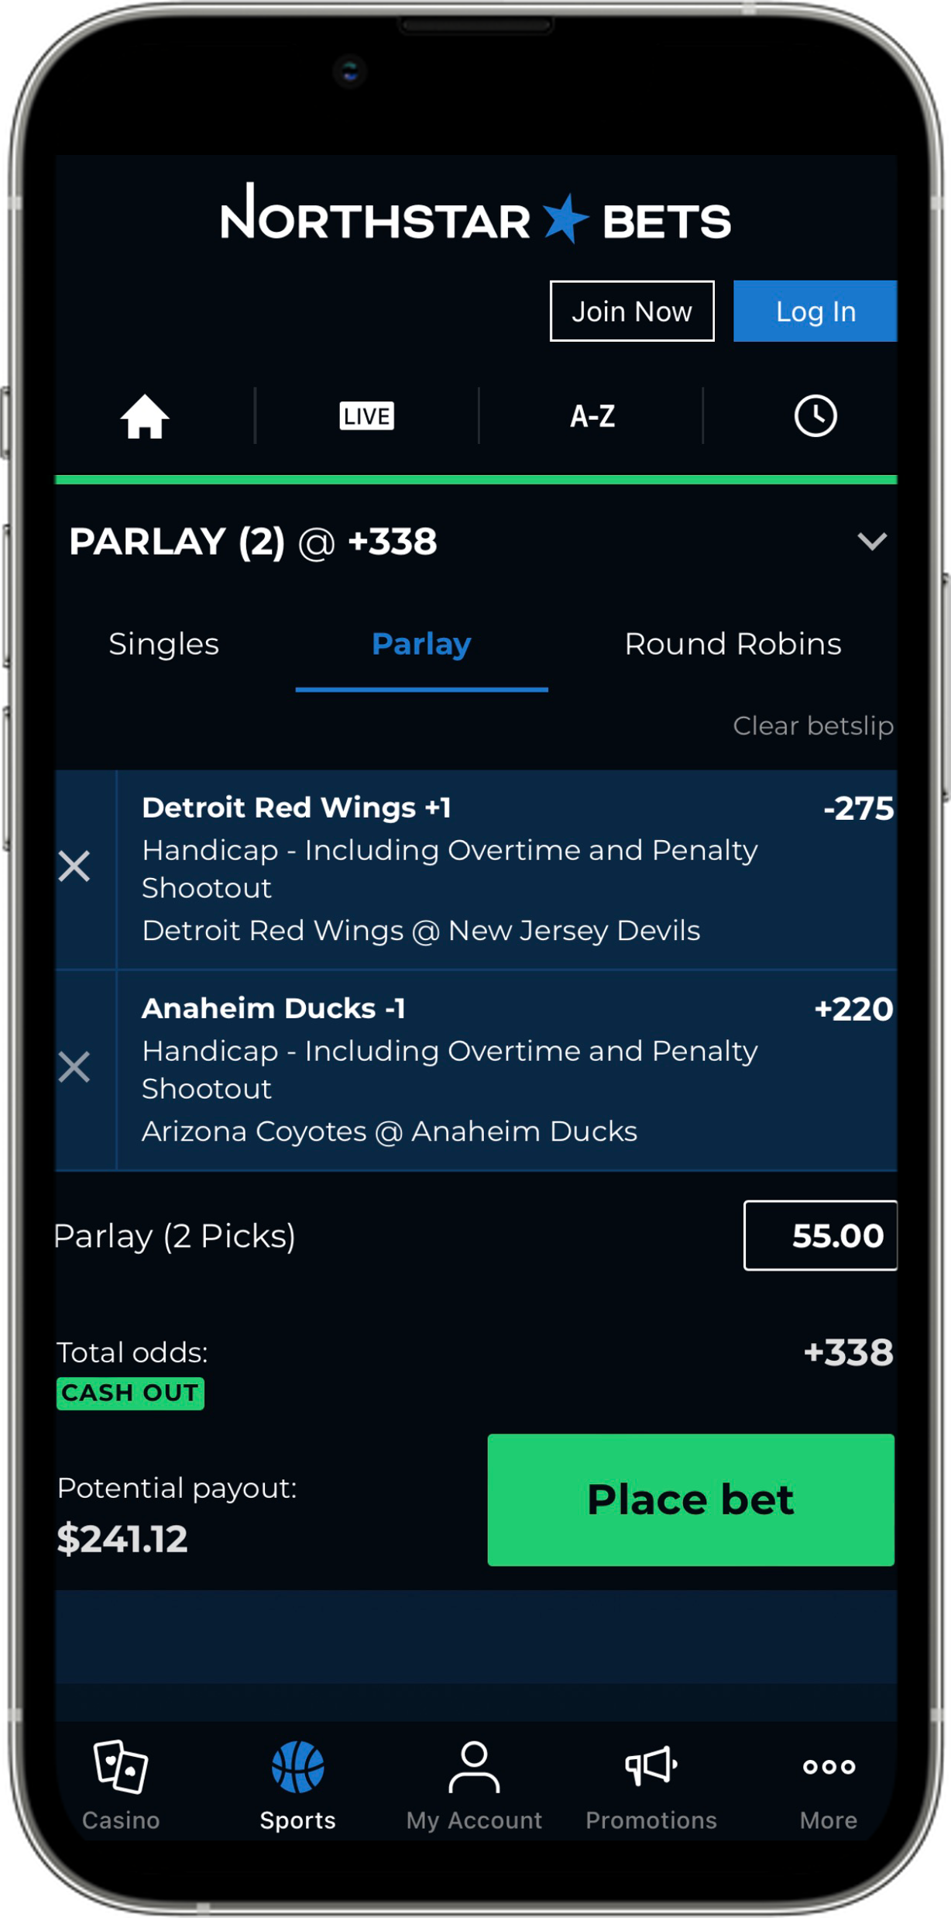
INVESTMENT HIGHLIGHTS
01
~C$8.5B Canadian TAM, with Ontario’s regulated market launched in April 2022 and Market Expansion to Rest of Canada November 2023*
02
Industry leading 3rd party gaming content
03
Cornerstone investment by Playtech PLC
04
Experienced management team with local knowledge and insights targeting the Canadian audience
05
Attractive payback rates on acquired players**
06
Variable cost model fully aligning incentives amongst vendors and NorthStar Gaming
*NorthStarBets.com is owned and operated by the Conseil des Abénakis de Wôlinak and is licensed by the Kahnawake Gaming Commission, license number 00930. The trademark NORTHSTARBETS is used under license.
**Based on comparison of NSG’s average Customer Acquisition Cost (“CAC”) per player / monthly average Gross Gaming Revenue (“GGR”) per player versus two industry competitors.
Notes:
“Canadian National Coverage, inclusive of a regulated platform built exclusively for ON”

Slide 5
CANADA IS A POTENTIAL C$8.5B MARKET
    Regulated Ontario Market ~C$540M Q223, On Track to Reach C$2.6B for CY24
Projected Canada and Ontario Online Sports Betting and iGaming* Market Size (2026E)**
(C$ billions)
C$8.5B
Total Market
C$3.3B
Total Market
Note: Canada estimates based on extrapolating Ontario estimates to the entire country based on population
**Source: PwC – Global Centre of Excellence for Betting & Gaming Lessons from Int’l Markets June 2022
*iGaming encompasses online casino games and other online non-sports betting wagers
Notes:
Regulated Ontario GGR~C$545M Q1232, growing 37% every quarter,
on track to reach C$2.6B for FY243

Slide 6

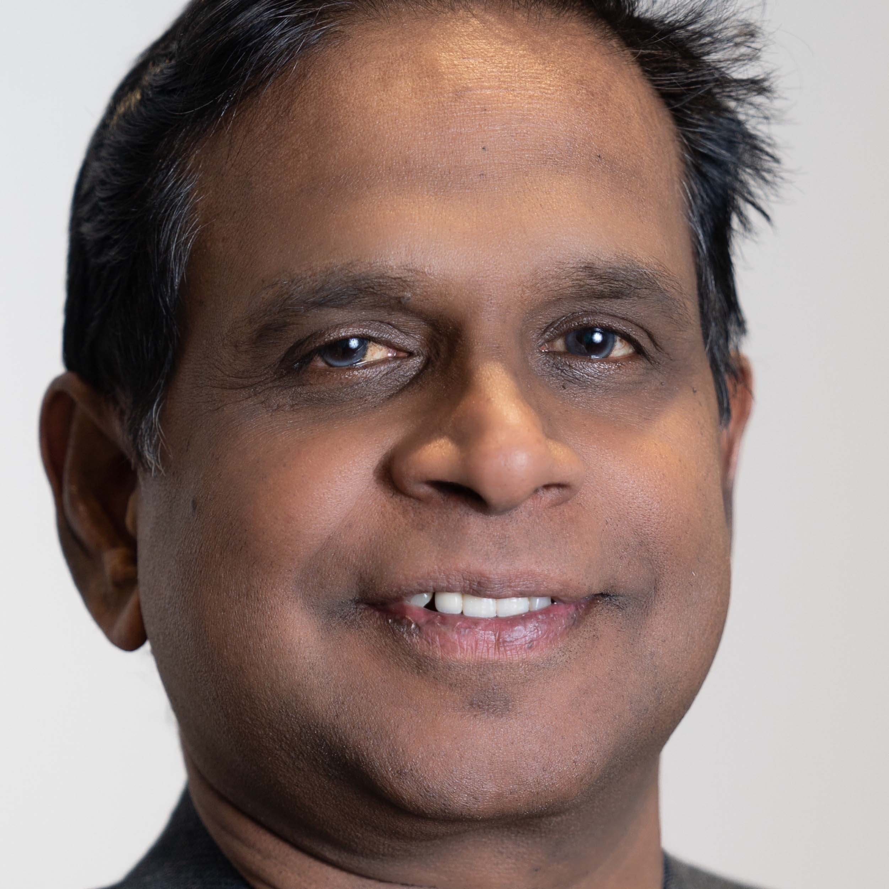









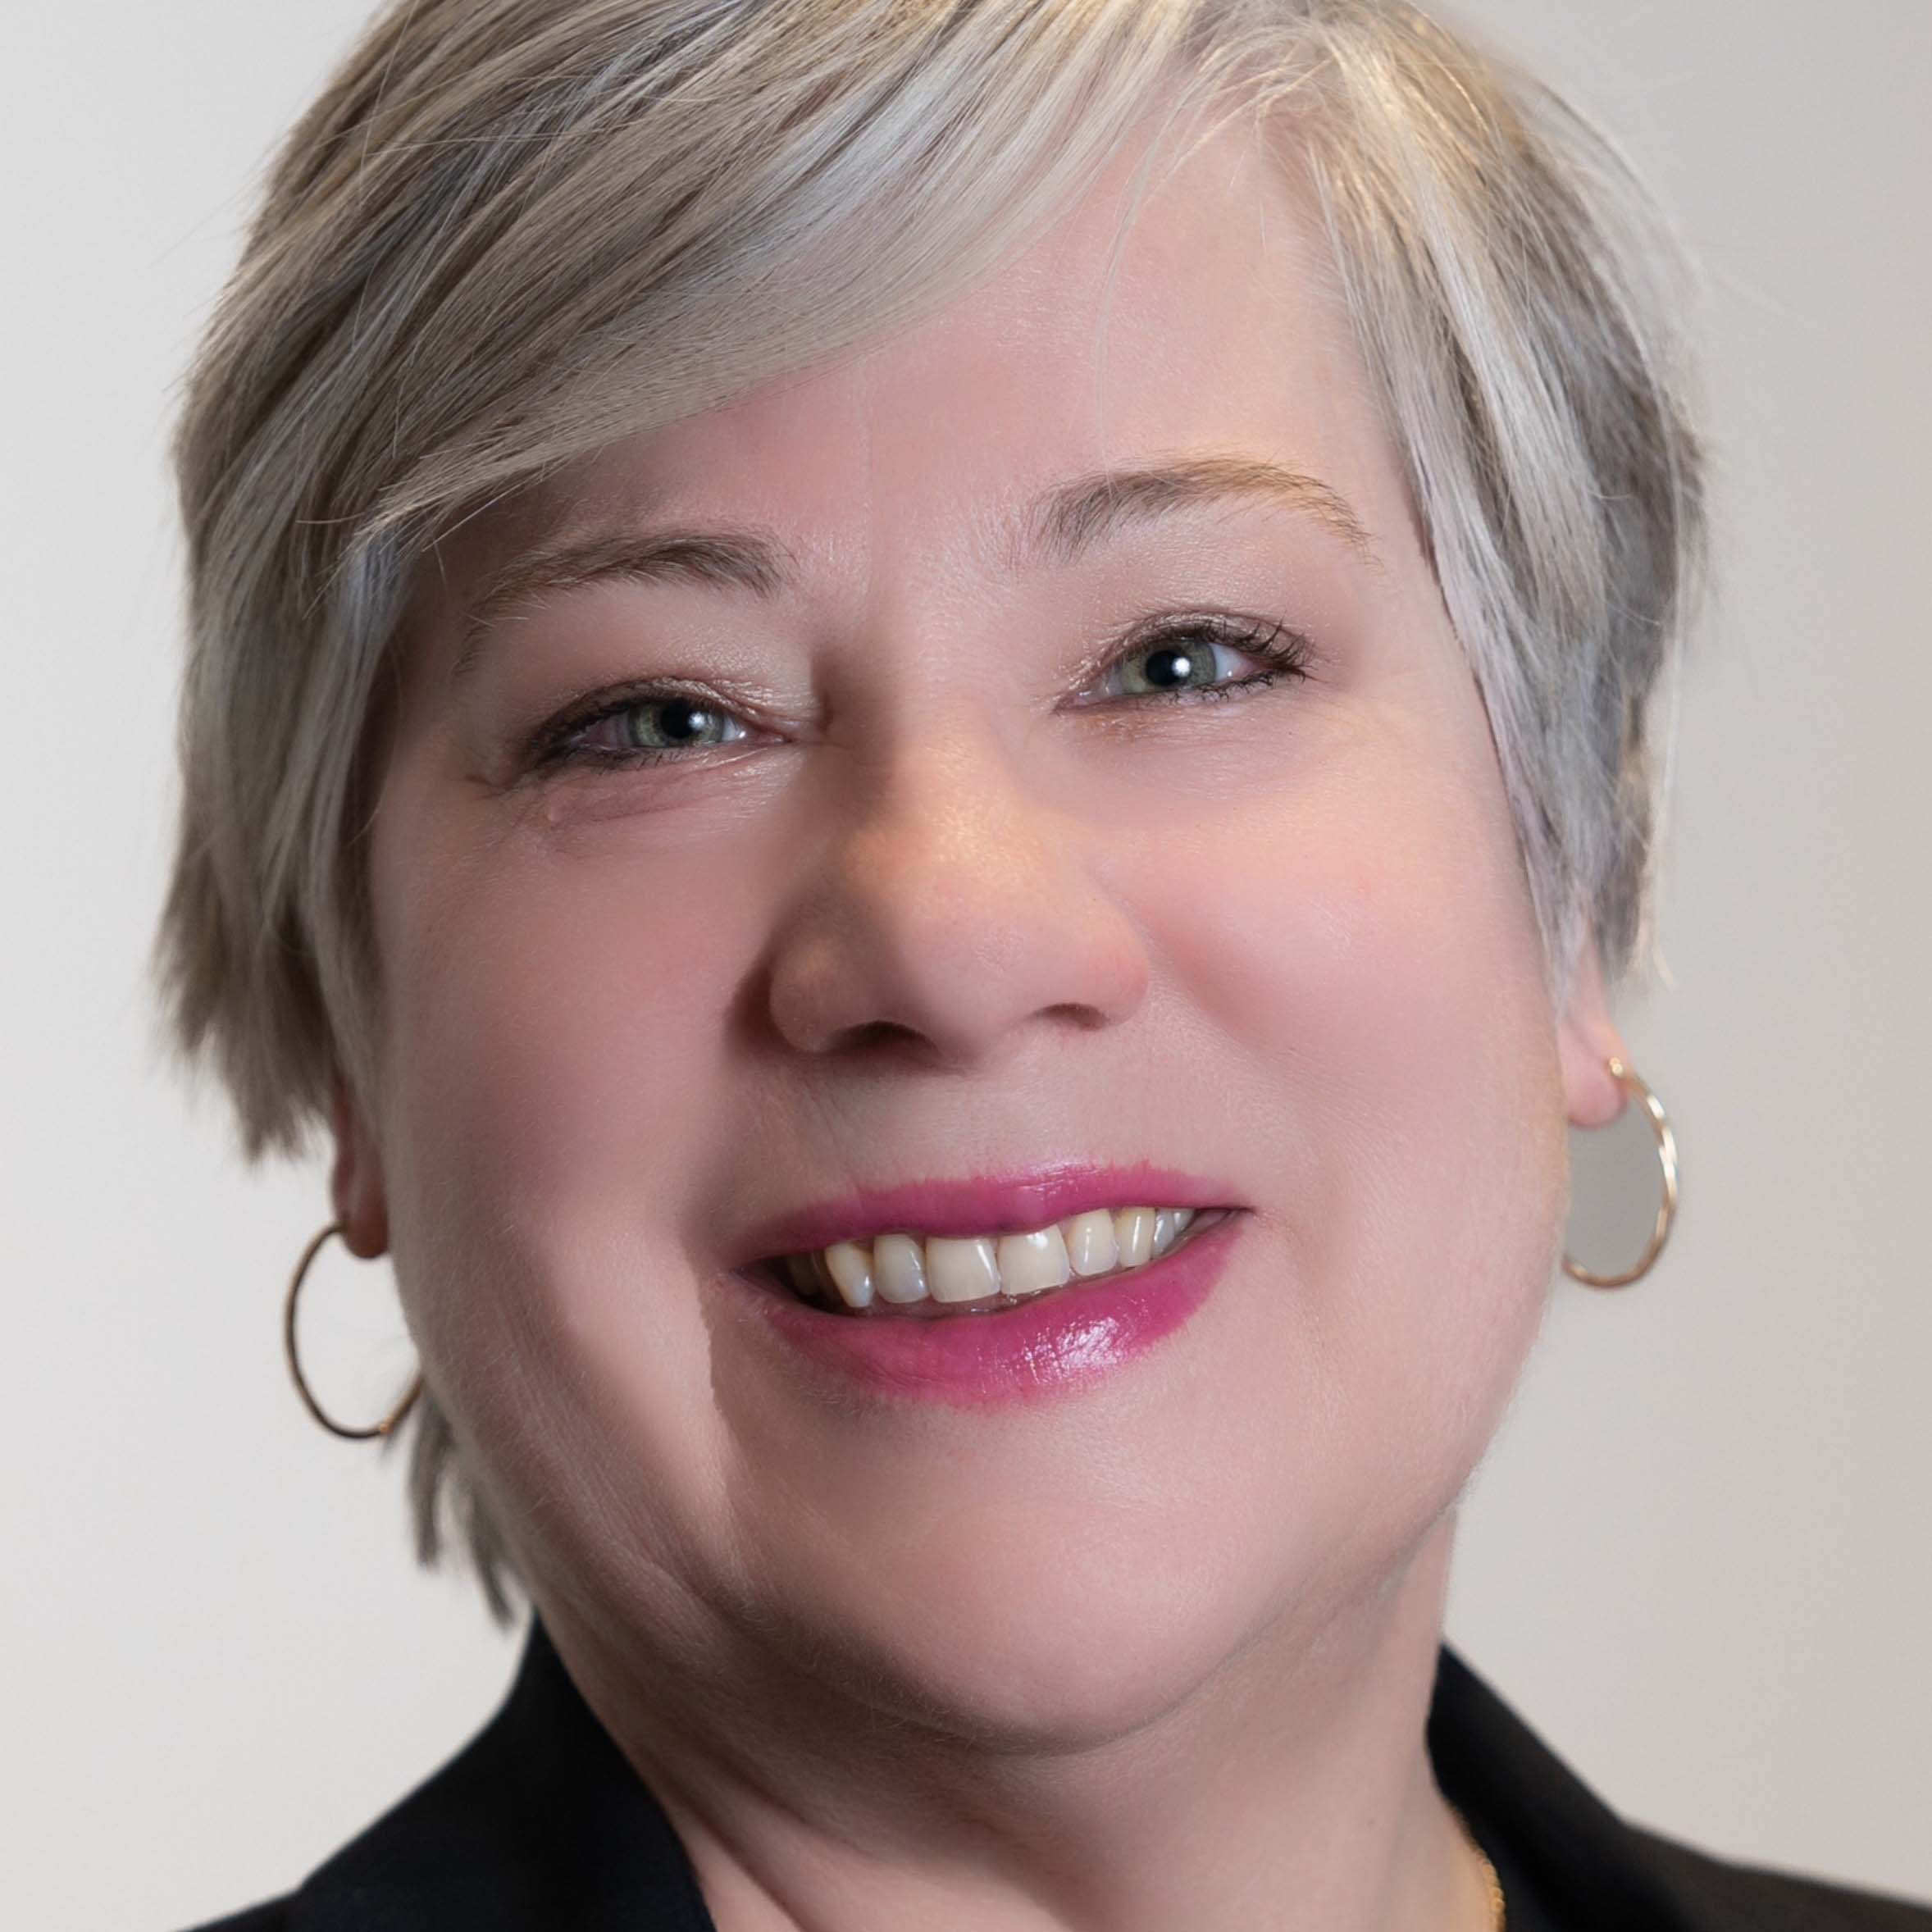




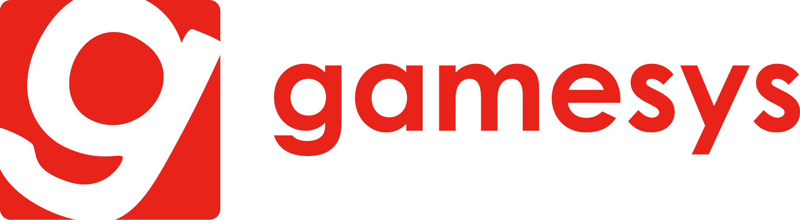



NORTHSTAR GAMING MANAGEMENT TEAM
Michael Moskowitz
CEO & Chairman
Chin Dhushenthen
Interim CFO
Corey Goodman
CDO and General Counsel
Brings 25+ years in the electronics industry and was previously the Chairman and CEO of Panasonic North America
Chin has held numerous executive positions across a wide variety of functions including finance, risk management, and technology
Corey has held a variety of senior executive roles in both a legal and corporate development capacity for nearly 20 years
Maureen Rydzik
VP IT and Vendor Management
Dante Anderson
VP Marketing
Gil Steinfeld
Strategic Advisor
Maureen has over 20 years of IT, program management and transformation leadership experience obtained at leading Canadian media, telecommunications, and IT services companies.
Dante has 15 years of strategic marketing experience including 9 years of regulated gaming industry experience with Ontario Lottery and Gaming
For 20 years Gil has been an iGaming Consultant for Virtual Commerce Solutions
Former Territory Manager for bwin, a subsidiary of Entain and general manager of Gamesys

Slide 7
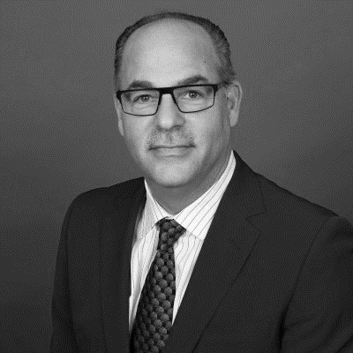















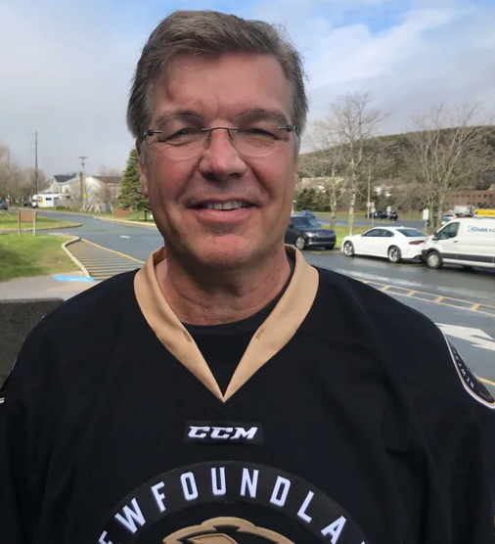
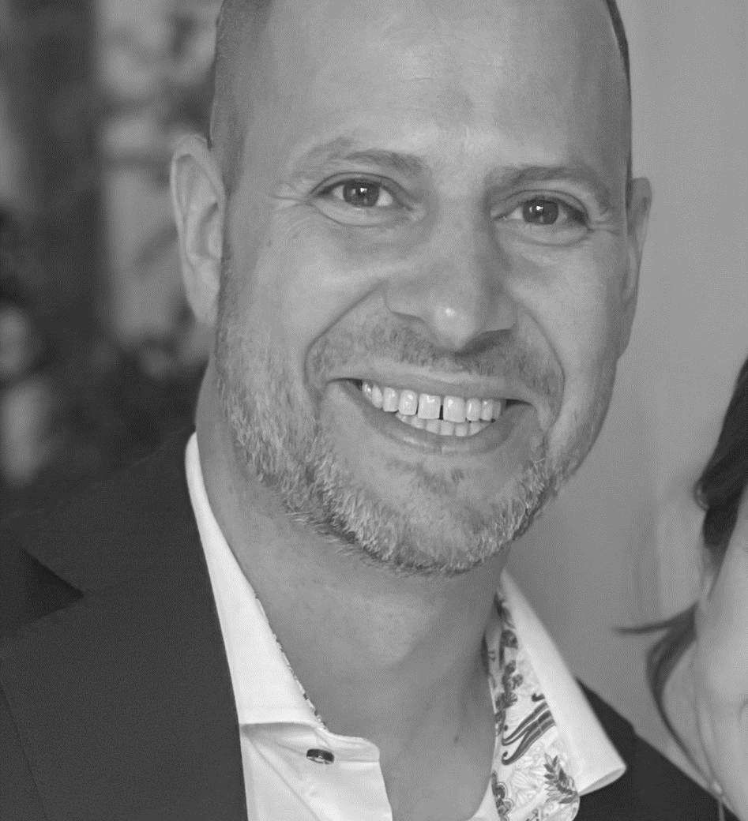
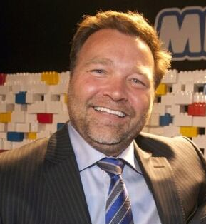
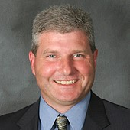
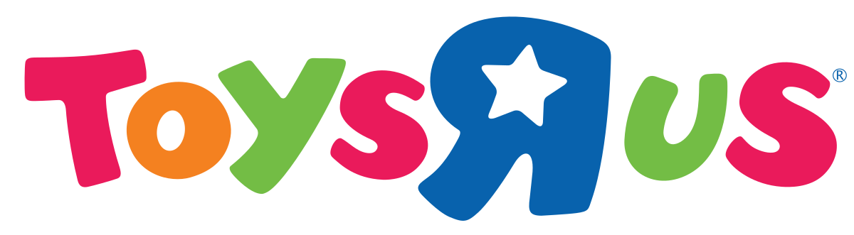


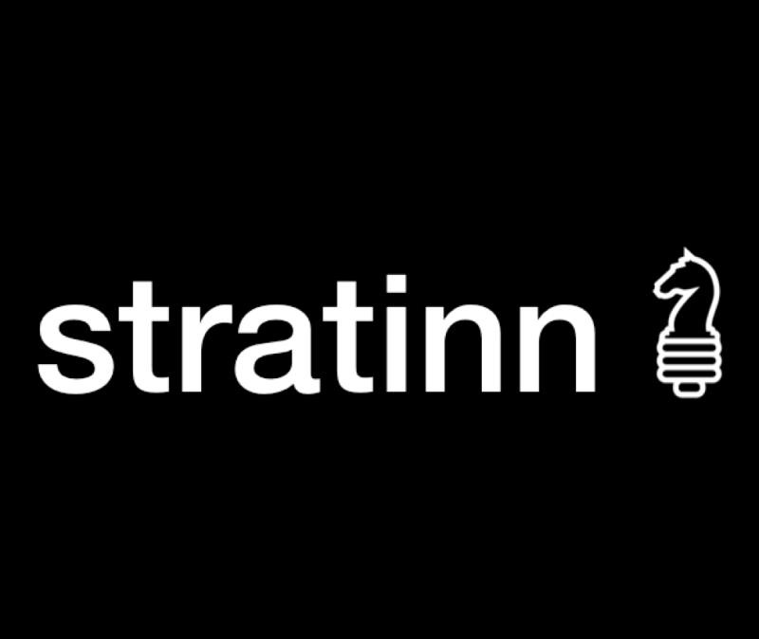






BOARD OF DIRECTORS
Barry Shafran, CPA
Lead Director, Audit Chair
Brian Cooper
Director
Chris McGinnis, CPA, CFA
Director
Sylvia Prentice
Director
Barry was the founder and CEO of Chesswood group from 2006 until 2020
Brian founded S&E Sponsorship group, eventually selling to Dentsu Aegis Network (MKTG) where he is the current Chairman
Chris is currently the CFO of Playtech PLC
Sylvia is currently the President of MacKinnon Calderwood Advertising where she has held various roles over a 22+ year career with the company
Dean MacDonald
Director*
Alex Latner
Director
Vic Bertrand
Director
Chris Hodgson
Director
In 2007, Dean was selected as CEO of the Year by Birch Hill Capital Partners and has held Chairman/CEO roles at ClearStream Energy, Tuckamore Capital and Persona Inc
Alex is currently General Counsel to Playtech PLC
Vic previously held titles of Director, Chief Innovation Officer, and COO at MEGA Brands where he worked for 28 years
Chris is a former MLA where he held numerous ministerial posts and was Chairman of Management Board of the Cabinet
*Chair of Comp. and Governance Committee

Slide 8











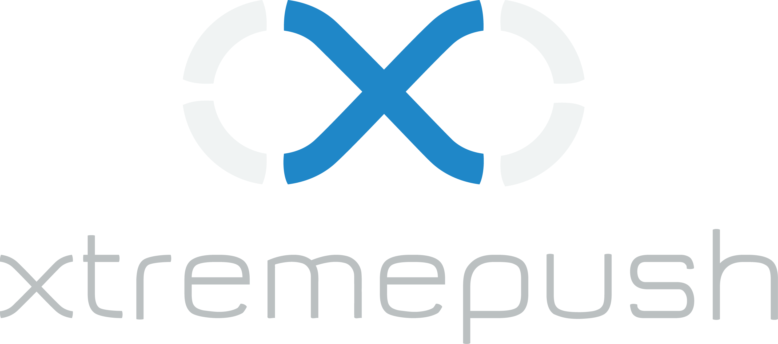

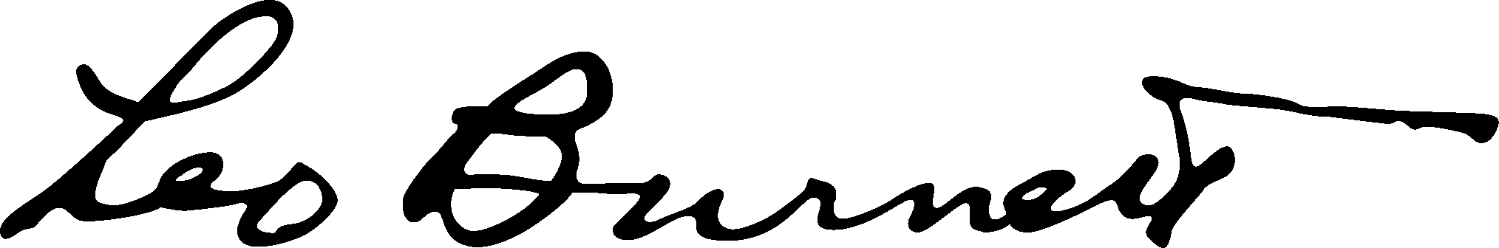




NORTHSTAR GAMING ENGINE
Proprietary Technology Stack, Combines Joint Ventures With Leading Global Players In Playtech And Kambi
The NorthStar you see
MOBILE
DESKTOP
iGAMING & MANAGED SERVICE PLATFORM
SPORTSBETTING PLATFORM
The NorthStar you don’t see
BETTING LINES / GAMING CONTENT
DIGITAL MARKETING / CONTENT
& DATA SCIENCE
FRAUD PREVENTION & PAYMENTS SOLUTIONS
REGULATORY COMPLIANCE
Note: Select partnerships with 3rd party service providers; Microgaming under negotiation

Slide 9





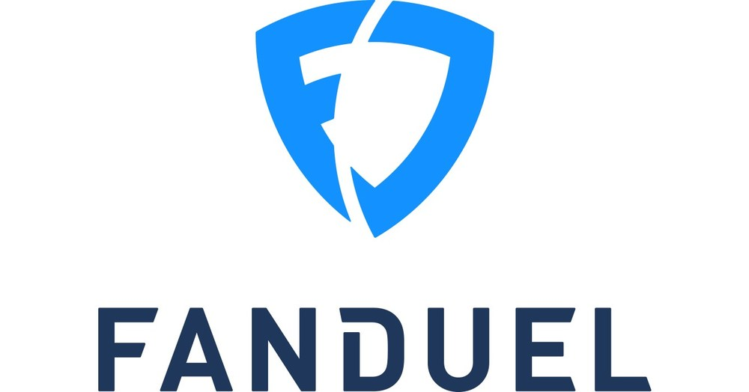


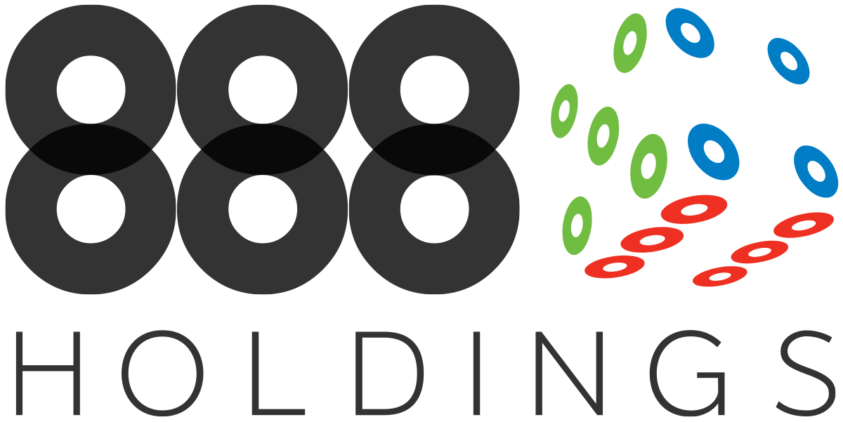
DIFFERENTIATED PRODUCT AND BUSINESS MODEL
By 2024 the Canadian market is estimated to reach C$6.7B in GGR¹
    NorthStar is Well Positioned to Compete in Ontario and Beyond
    NorthStar Competitive Advantage:
      Premium features such as Sports Insights provides unique point of differentiation
      Custom built product designed to fit inherent expectations of premium players
      Focused 100% on the Canadian market
      Top-tier tech partners empowers NorthStar to focus exclusively on players acquisition and retention
FY2024E market share for niche operators ~C$1.3B
NorthStar well positioned to gain a disproportionate market share
3% of market share would equate to C$200M revenue
2
1. PwC Global Centre of Excellence for Betting & Gaming
2. Cormark Securities Gaming Industry Trends Oct 2022
Notes:
Custom built product designed to fit inherent expectations of premium players
Robust technical partnerships to support quality and service expectations of a world class product
Premium features such as Sports Insights with a focus on the most valuable 10% of customers
Business focused on building most coveted database in Canada
FY2024E market share for smaller operators ~1.3B
NorthStar well positioned to gain a disproportionate market share.
3% of market share would equate to C$200M revenue

Slide 10
COMPETITIVE PAYBACK RATIO
Attractive
payback ratio on acquired players
190% lower
340% lower
¹
Competitor #1
²
²
Competitor #2
1. NSG Since Inception CAC per player/ monthly average GGR/player
2. Competitors both publicly listed companies with a market cap >C$$250 million, payback ratio calculated internally based on trailing three quarters of publicly available information

Slide 11











NORTHSTAR SPORTS INSIGHTS
Why Content?
Consumers of NorthStar’s in-house sports content translate to higher player values when compared to NorthStar average customer:
Higher average deposit
Higher Casino turnover
Higher total GGR
Higher Sport turnover
Mike Cormack
Head of Content
Chris Toman
Managing Editor
Staff Writers:
Jordan Horrobin
Stephen Psihiogos
Avery Perri
Mike has two decades of experience in Canadian sports media, holding a variety of editorial leadership roles
His strengths are developing and leading successful multiplatform content teams and strategies
He was previously Managing Editor of The Athletic, Toronto and Managing Editor of sportsnet.ca
Chris has a wealth of experience creating content for the sports media environment
Most recently Chris provided leadership to a team of publishing editors at Sportsbook Review
Prior to that he was a Publishing Editor at Covers and Sports Editor with Vice Canada where he executed and launched their creative vision
A talented and diverse group of sports journalists with experience producing premium betting content across a variety of sports

Slide 12

NORTHSTAR CUSTOMER JOURNEY

Slide 13
NORTHSTAR’S KEY PERFORMANCE INDICATORS*
Q3 Continued NorthStar’s Strong Growth
* NorthStar Commenced Operations Q2 2022

Slide 14
Rest of Canada Expansion (“RoC”)
Provides a Clear Catalyst for Growth
Total addressable Canadian market, excluding Ontario
estimated at ~ C$5.2B¹ at maturity
Head start on future provincial regulation. Build database and
brand in advance of regulation
Operational benefits of expansion:
  High operating leverage by utilizing existing people/ assets to expand reach
  Commercial support from Playtech to expand geographically under
  contract extension
Demand Creation Leverage
  Currently ~33% of Canadian traffic to betting hub/Torstar originates outside of Ontario
  Ability to monetize current spill of multi-media campaigns
ROC
13%
39%
ON
22%
PQ
25%
BC/AB
Ontario only accounts for 39% of the Canadian population
1, Source- PwC – Global Centre of Excellence for Betting & Gaming, ON estimated at C$3.3B

Slide 15

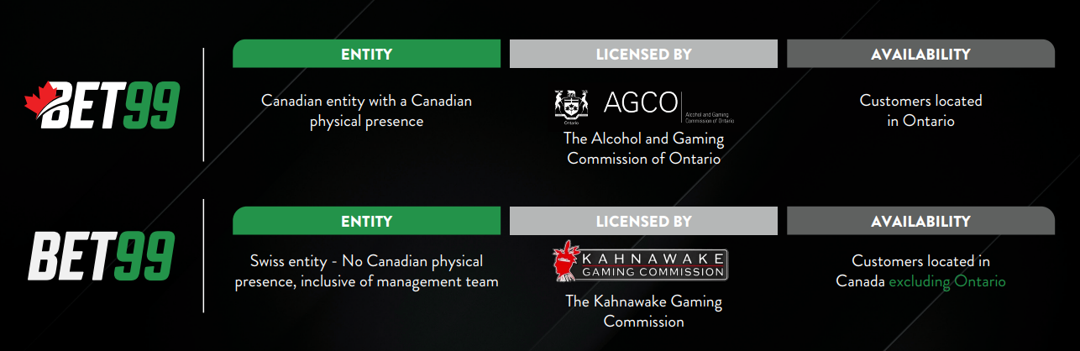
NORTHSTAR LICENSING
ENTITY
LICENSED BY
AVAILABILITY
Canadian entity with a Canadian physical presence
Customers located in Ontario
.CA
The Alcohol and Gaming Commission of Ontario
ENTITY
LICENSED BY
AVAILABILITY
Managed services provider to northstarbets.com*, iGaming site owned and operated by the Abenaki Council of Wolinak
Customers located in Canada excluding Ontario
.COM
The Kahnawake Gaming Commission

Slide 16
KEY MILESTONES
COMPLETE
COMPLETE
COMPLETE
December 2022
May 2023
November 2023*
FY2024
Final Phase Strategic Investment
Playtech plc, a leading B2B platform provider invested $12.25M into the Company by way of a convertible debenture. Playtech’s investment further deepens the partnership with NorthStar, expands contract geography to include all of Canada and provides NorthStar with sector expertise
Slapshot Media Acquisition
NorthStar acquired Slapshot Media Inc., a marketing and managed services provider to Spreads.ca, an iGaming site owned and operated by the Abenaki Council of Wolinak. Slapshot enables NorthStar to expands its’ operations outside Ontario and across the rest of Canada
Launched “.com” in Rest Of Canada
NorthStar in partnership with Playtech rebranded spreads.ca into Northstarbets.com during the busy Q4 sports season, opening the remaining 61% of the Canadian market to NorthStar
Margin Expansion
Continue to scale revenues through market expansion with existing and new partnerships
Keep expenses low
Optimize marketing efficiency
COMPLETE
COMPLETE
March 2023
October 2023
1H 2024
IPO and Business Expansion
NorthStar successfully listed on the TSX-V exchange March 2023
Playtech 2nd Strategic Investment
Playtech plc, has invested an additional $10.0M into NorthStar to continue to advance the company’s reach across Canada and expand the company’s Ontario market share. NorthStar will continue to leverage Playtech’s strategic advice, specifically regarding online operations, managed services and market expansion
Expanded Product Offering
New Games
Branded Tables
Insights 2.0
iBingo
Enhanced User Experience
*NorthStarBets.com is owned and operated by the Conseil des Abénakis de Wôlinak and is licensed by the Kahnawake Gaming Commission, license number 00930. The trademark NORTHSTARBETS is used under license.

Slide 17
CAPITALIZATION
Rivett & Related Entities
Other Shareholders
192.8 million shares outstanding
Bitove & Torstar Entities.²
Directors & Senior Officers
Playtech
1. Treasury method applied to dilutive units, except 12.1M RSU. 56.2M warrants outstanding at a weighted average strike price of $0.60, 13.2M options outstanding at a weighted average strike price of $0.39
2. Torstar controlled by Jordan Bitove
3. Debentures convertible at $0.20, 8% interest paid-in-kind
Notes:
Reported Cash Q3 + Announced Financing reformat cash

